Slide 1
Reinforcement Learning
Done by:
Goh Rui Zhuo (2222329) and Toh Kien Yu (2222291)

Slide 2
Table of contents
Background Research + Approach Taken
Application of RL and Evaluation
( Rationale + Explanations)
Model Improvement
Final Model

Slide 3
01
Background Research

Slide 4
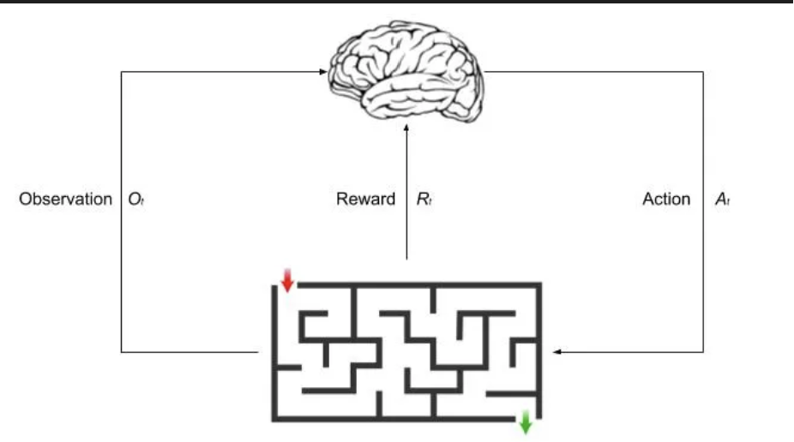
Background Research
What is reinforcement learning?
Reinforcement learning can be viewed as an form of learning between supervised and unsupervised.
Reinforcement learning involves no supervisor and only a reward is used for a is used for an agent to determine if they are doing well or not. Here, time is key component in RL where process is step by step with delayed feedback.

Slide 5
Approach Taken
At first, we didn’t use target network we use the lab code
After that we decided to try target network with the implementation of school using DQ in the school lab code.
After that we utilized replay buffer.
We then further improved baseline model 2 and baseline model 3

Slide 6
02
Application of RL

Slide 7
Baseline 1
Neural Network: Generally, in here, we tried to set the neural network to as simple as possible to see how much it needs and require here generally, hence we have a 2 dense layer vanila model here
Remember method: As we state earlier, Reinforcement Learning requires remember to store experiences such as the state action reward, next start and done
Choose action: This is to decide whether to take a random action or the best action based on the epsilon value which overtime will decrease
The agent here learn by trial and error and random sampling base on past experiences which reduces correlation between experiences and stabilises learning
Epsilon decay reduce the amount of random action selection as the agent become more trained

Slide 8
Baseline 1
Key Ideas
This learns to performs action to maximise total rewards.
Deque is used to store experiences allowing the agent to learn from past actions, rewards and outcomes.
Discrete action space was used to samples and decide to best course of action at each step
In terms of policy,
Epsilon greedy strategy was used, balancing exploration and exploitation and as the agent learns more about the environment, the epsilon decays shifts from exploration to exploitation
The replay method then utilizes these samples to perform gradient descent on difference between predicted Q values and target Q values, improving the model policy over time
The trainer class sets the running the agent

Slide 9
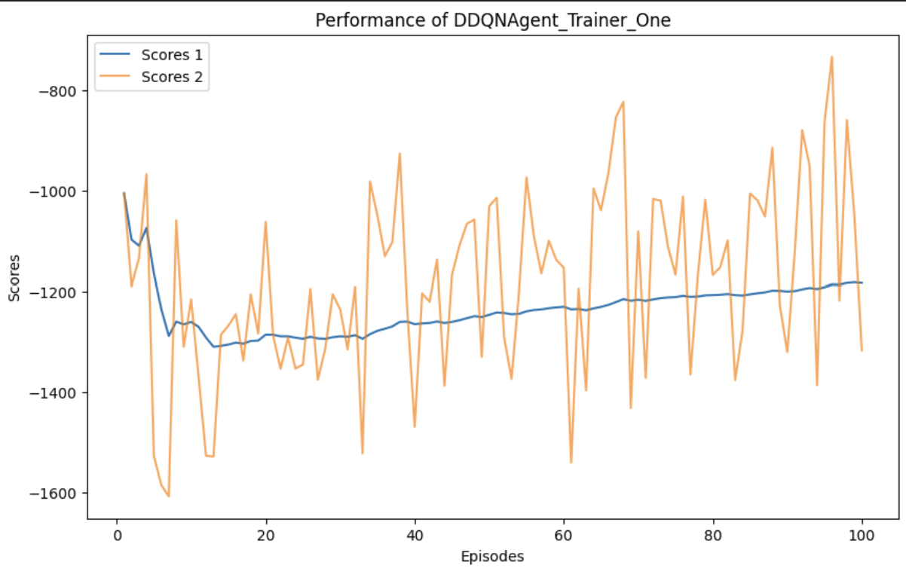
Baseline 1
The score per episode fluctuates greatly while the average score per episode drops then slowly increases.

Slide 10
Baseline 2
This introduces a target network in addition to the main network. The target networks weights are updated less frequently than the main network's weights, providing stability to the learning process
This introduce a second network to provide much needed stability in Pendulum environment
Similar epsilon gradient policy is utilise here

Slide 11
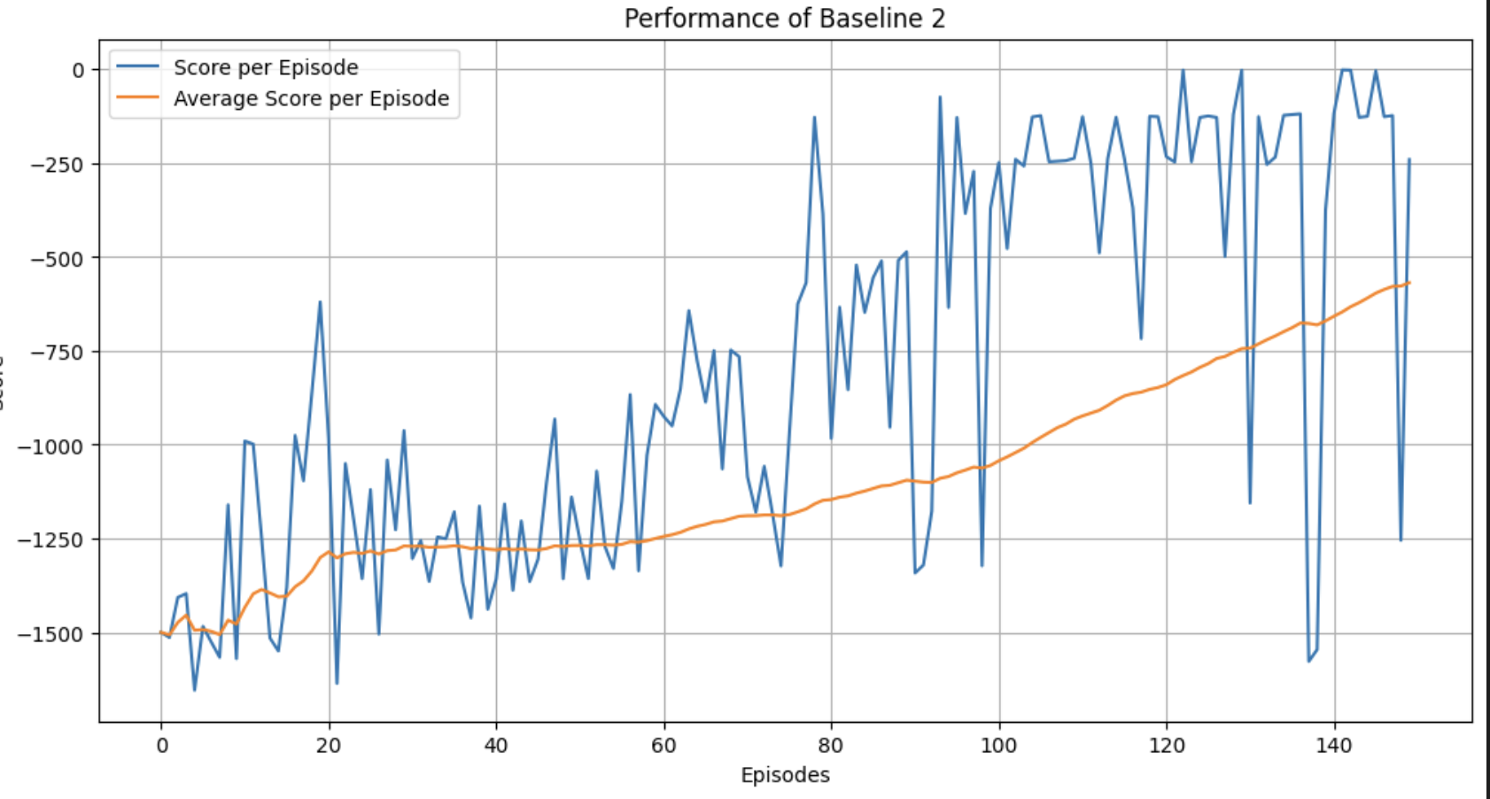
Baseline 2
The score per episode fluctuates while the average score per episode slowly increases.

Slide 12
Baseline 3
Neural Network: Generally, in here, we tried to set the neural network to as simple as possible to see how much it needs and require here generally, hence we have a 5 dense layer model here, with the addition of leaky relu here
Buffer Class: Creation
The agent here learn by trial and error and random sampling base on past experiences which reduces correlation between experiences and stabilises learning
Epsilon decay reduce the amount of random action selection as the agent become more trained

Slide 13
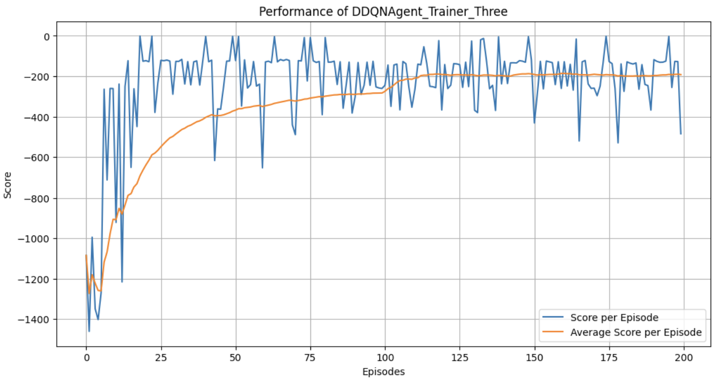
Baseline 3
The score per episode fluctuates while the average score per episode slowly increases.

Slide 14
Baseline 4
Neural Network: Baseline 4 was created as a Double Deep Q-Network model (DDQN ) with simplicity in mind with 5 dense layers with the use of LeakyReLU
Buffer Class: Creation
The agent here learn by trial and error and based on past experiences which reduces correlation between experiences and stabilises learning
It improves the sample efficiency when training

Slide 15
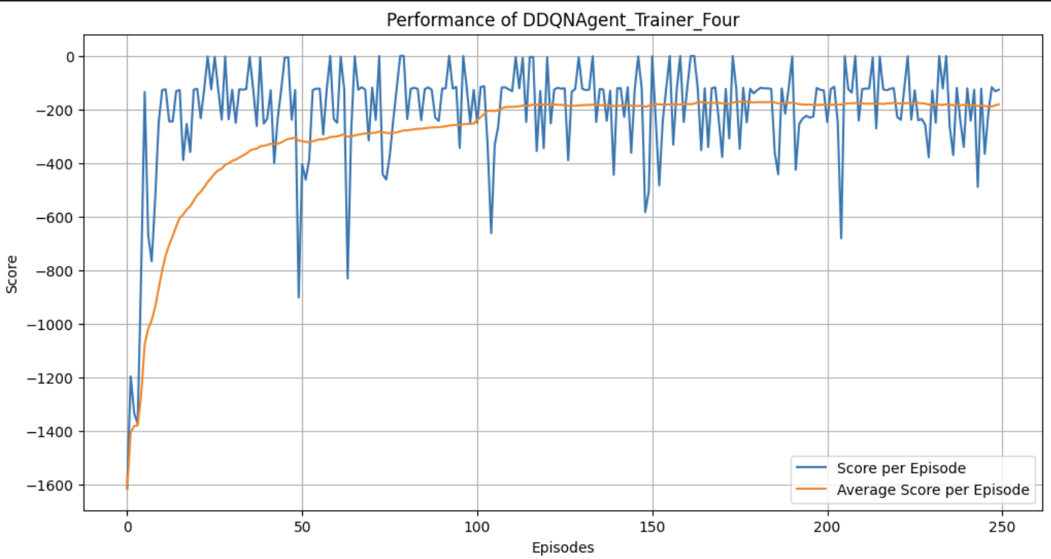
Baseline 4
The score per episode fluctuates while the average score per episode slowly increases.

Slide 16
Baseline 5
Neural Network: Baseline 5 is created as a Dueling DQN. The network basically estimates 2 things, the value of the given state and what the advantages are taking each possible action at that state
Buffer Class: Creation
The agent here learn by trial and error and random sampling base on past experiences which reduces correlation between experiences and stabilises learning
Random sampling
Epsilon decay reduce the amount of random action selection as the agent become more train.

Slide 17
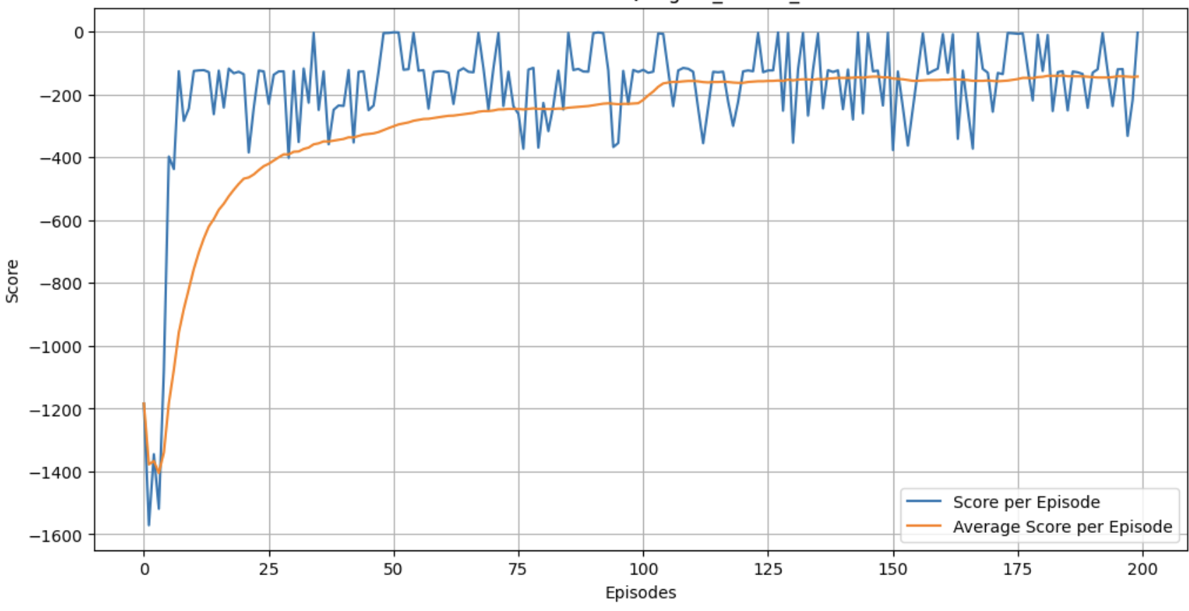
Baseline 5
The score per episode fluctuates while the average score per episode slowly increases.

Slide 18
04
Model Improvement
We will further improve baseline model 2 and 3

Slide 19
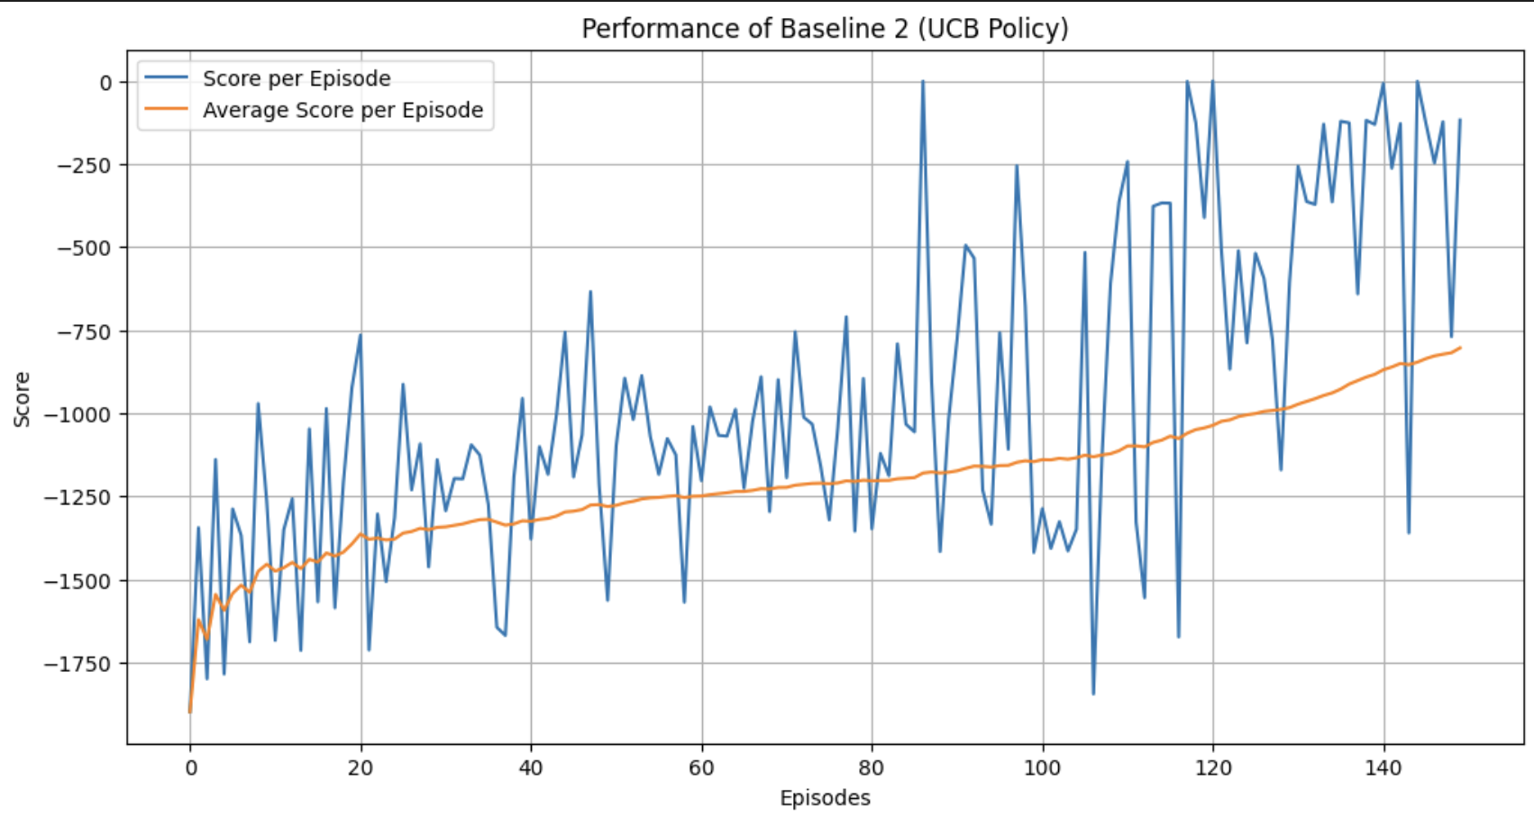
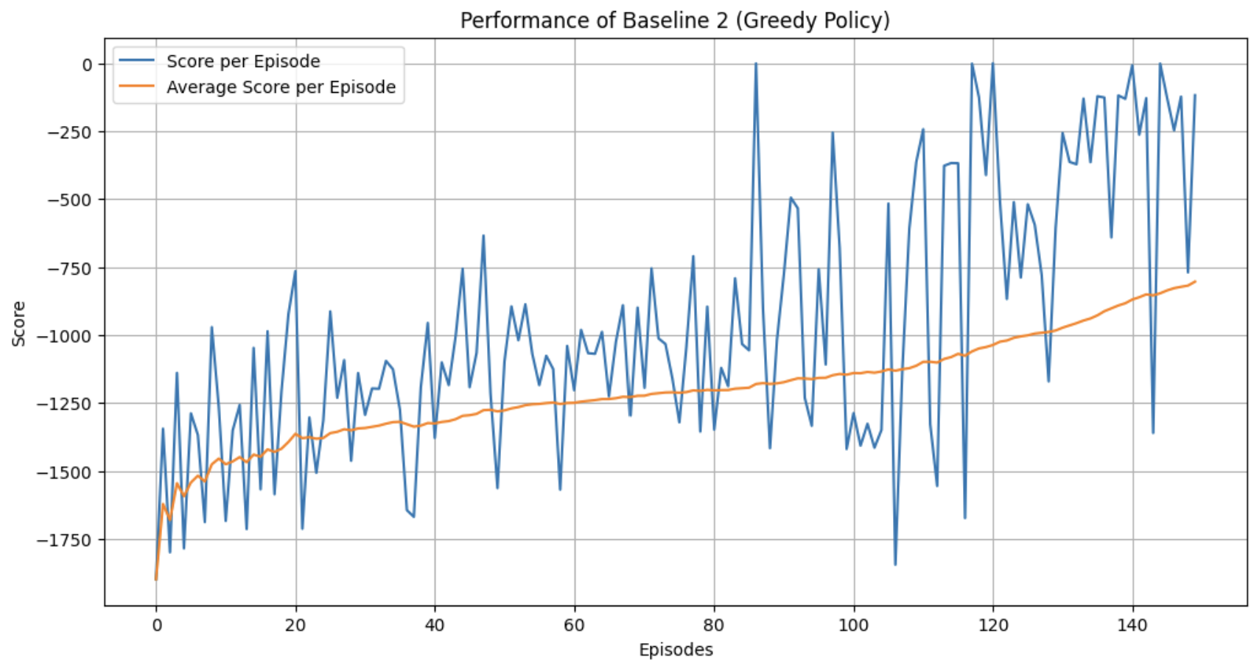
Model Improvement - Change Of Policy Type (Model 2)
UCB Policy focus on a more balanced approach, including discovering different course of actions. It mainly considers the variance in the reward estimate of each action
Greedy Policy focus on exploitation, selecting actions with highest estimate of rewards. It tends to not explore different routes
UCB Policy
Greedy Policy

Slide 20
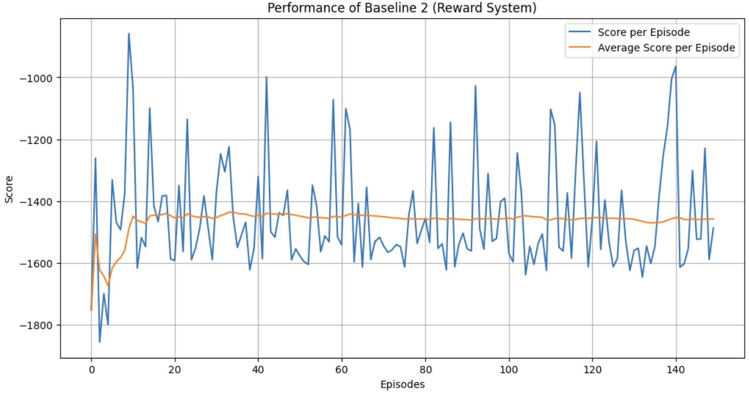
Model Improvement - Change Of Reward System (Model 2)
The reward system is customized and enables the agent to learn behaviours that are much more oriented to the objective of stabilizing the pendulum.

Slide 21
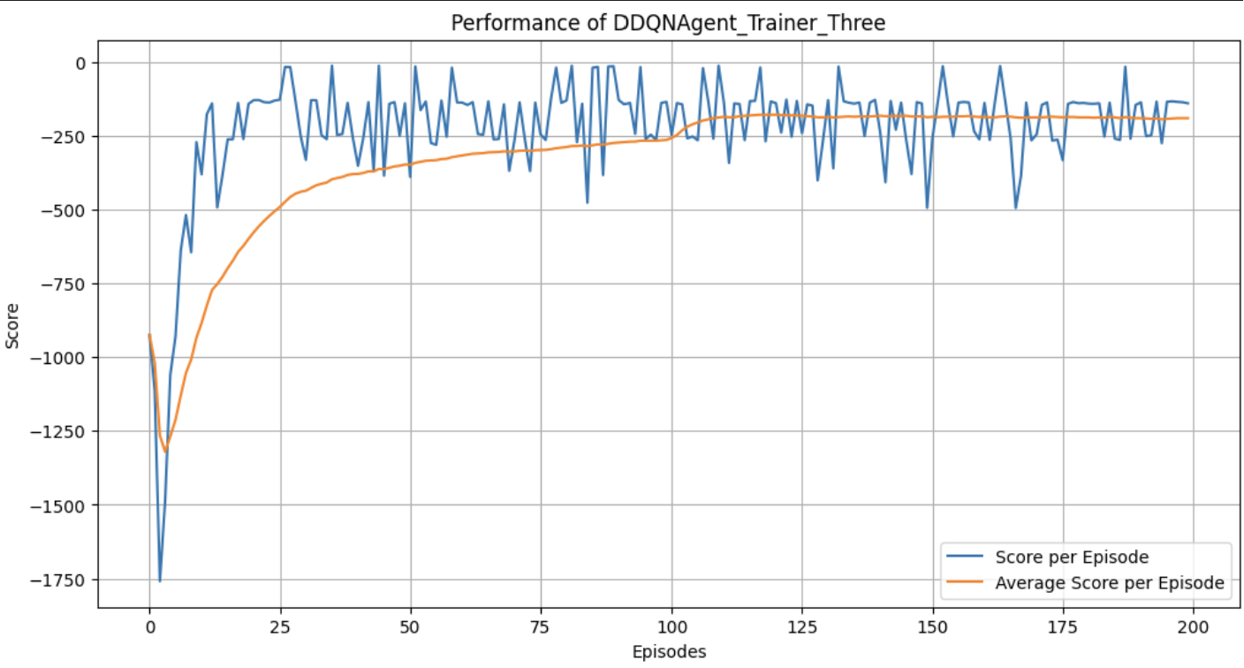
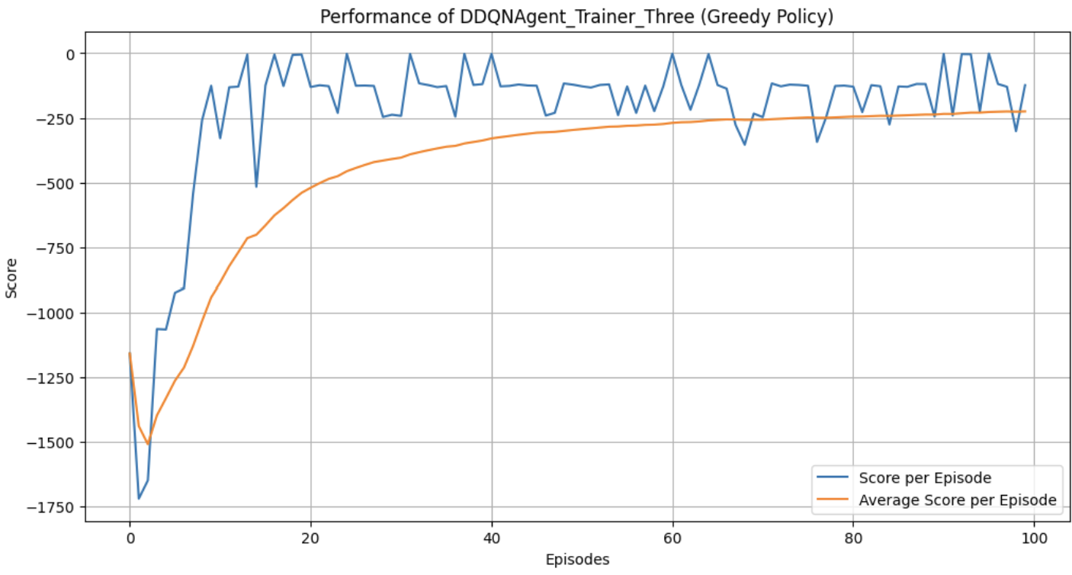
Model Improvement - Change Of Policy Type (Model 3)
UCB Policy focus on a more balanced approach, including discovering different course of actions. It mainly considers the variance in the reward estimate of each action
Greedy Policy focus on exploitation, selecting actions with highest estimate of rewards. It tends to not explore different routes
UCB Policy
Greedy Policy

Slide 22
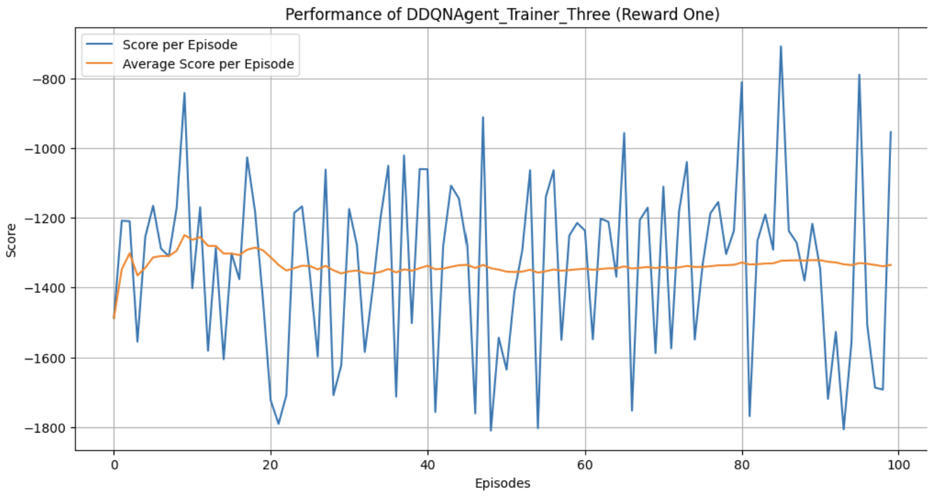
Model Improvement - Change Of Reward System (Model 3)
The reward system is customized and enables the agent to learn behaviours that are much more oriented to the objective of stabilizing the pendulum.

Slide 23
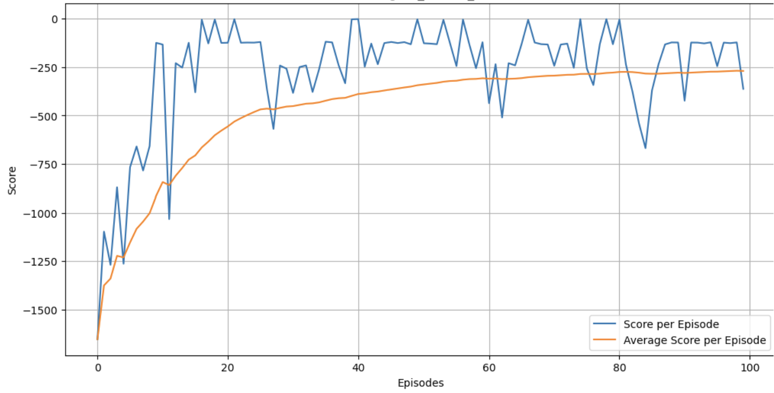
Model Improvement - Change of Loss Function (Hinge Loss) (Model 3)
Hinge Loss aims to find a decision boundary and not only penalizes wrong decisions but also penalize decisions that are not as confident. In order to not be penalized, the agent must have confident decision making as to what course of action it should take

Slide 24
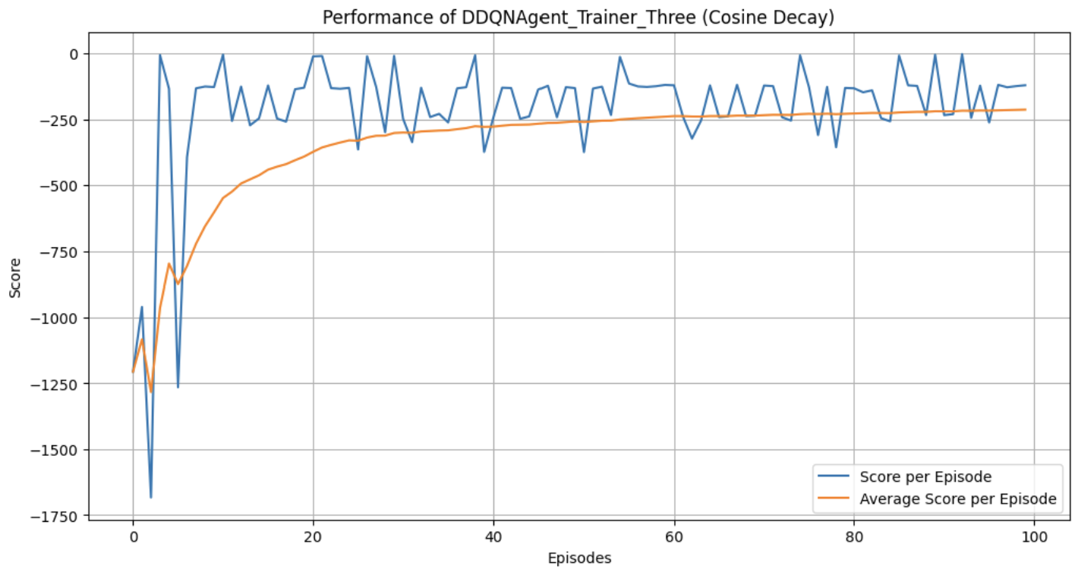
Model Improvement - Learning Rate Scheduler (Cosine Decay) (Model 3)
Cosine Decay adjusts the learning rate following the cosine curve. It can enhance the stability and efficiency of training process and achieve better performance.
The score per episode fluctuates while the average score per episode slowly increases.

Slide 25
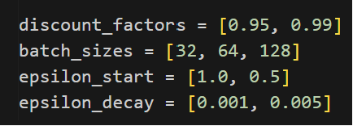
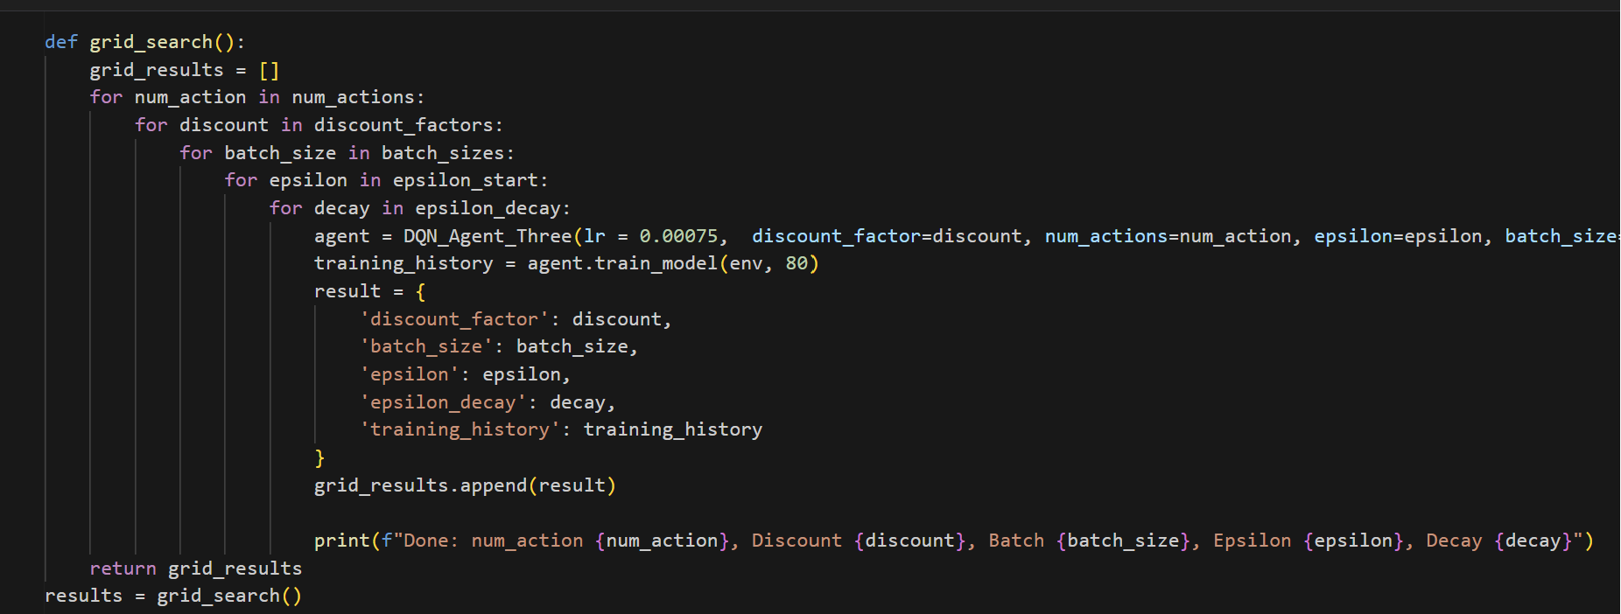
Model Improvement - Hyperparameter Tuning (Model 3)
Hyperparameter Tuning was done through a for loop function created to loop through all possible parameters.

Slide 26
05
Final Model
Baseline 3 (UCB Policy) will be used as our final model.

Slide 27
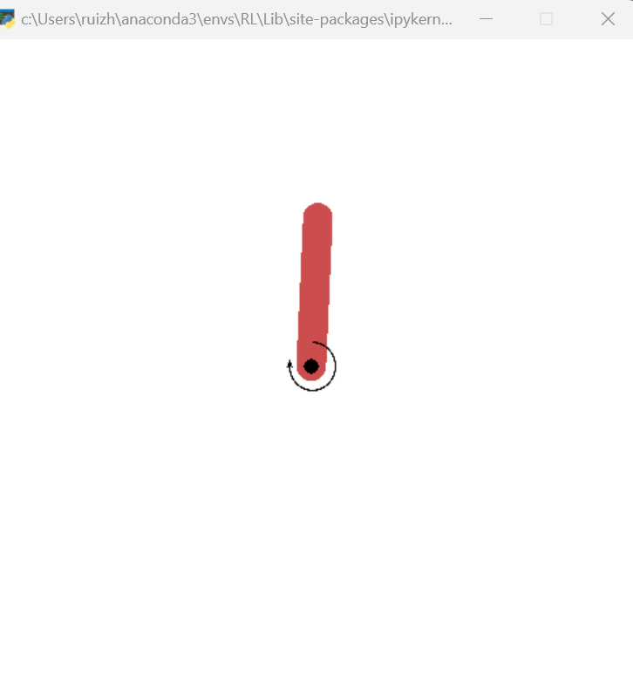
Final Model
The pendulum stabilizes after training for 2 episode.

Slide 28
Thank you!

